Slide 1
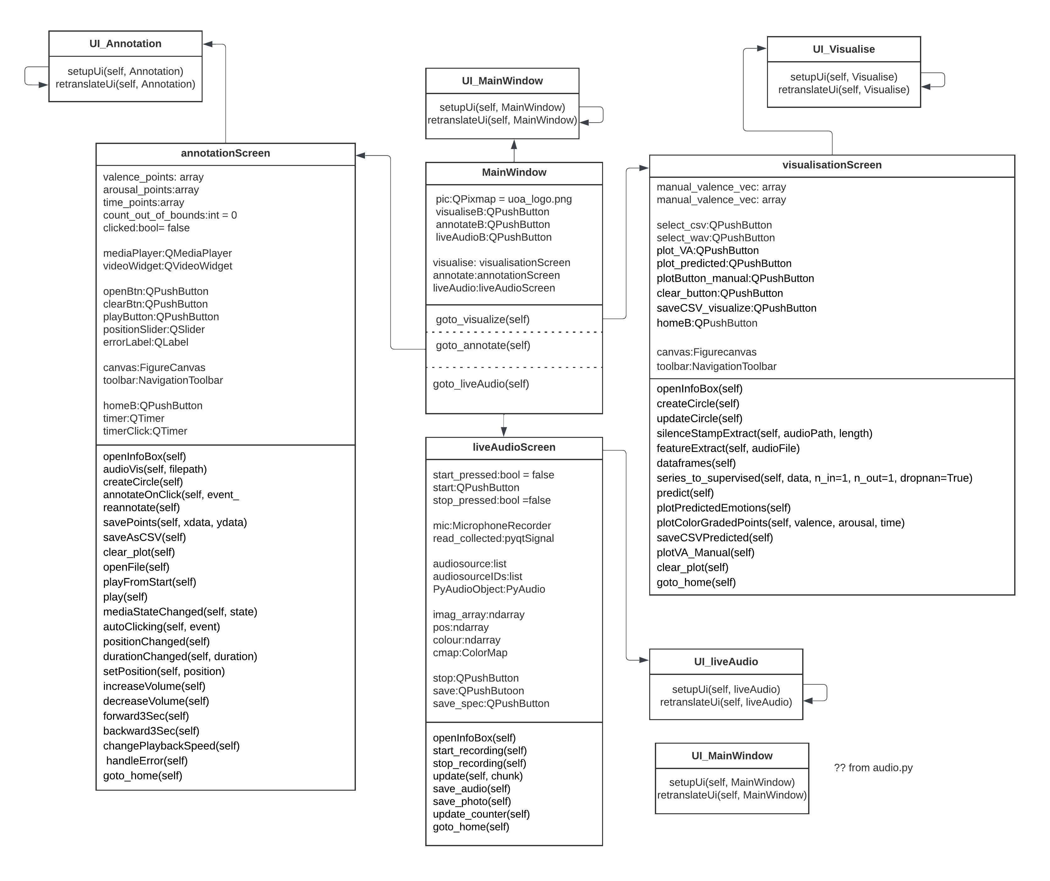
EmotionGui_ understanding PyQT code
Class Diagram

Slide 2
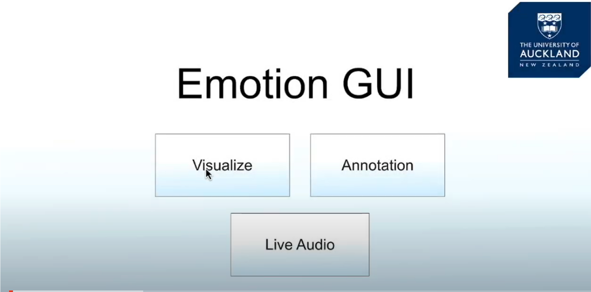
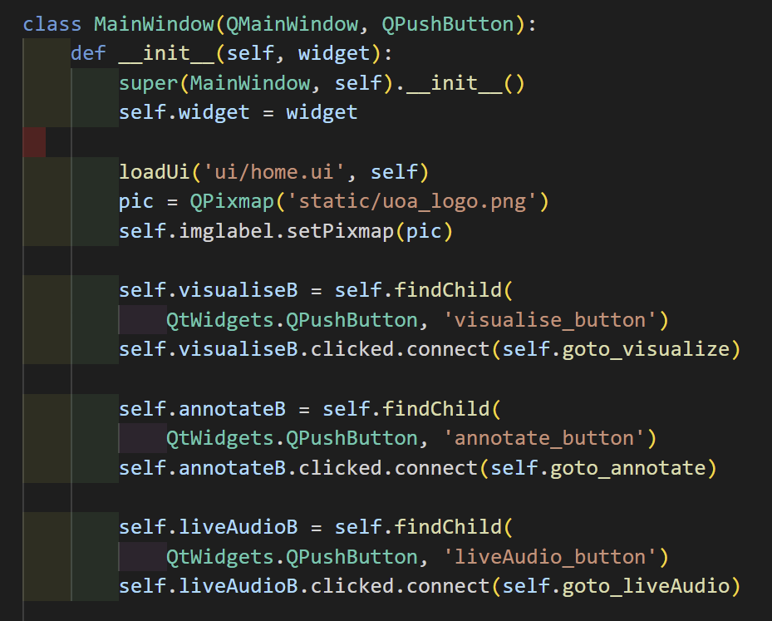
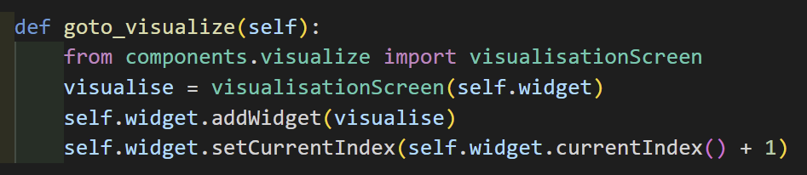
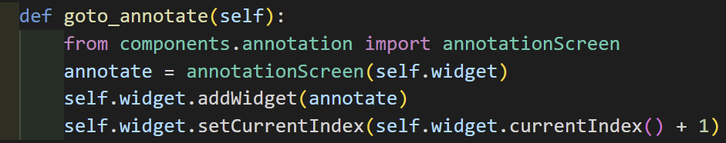
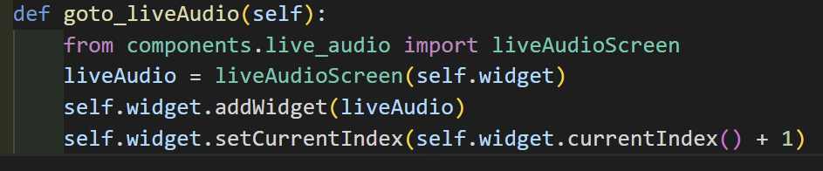

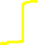
EmotionGui_ understanding PyQT code
Main Screen
Open visualise screen when clicking Visualize button
Open annotation screen when clicking Annotation button
Open live audio screen when clicking Live Audio button

Slide 3
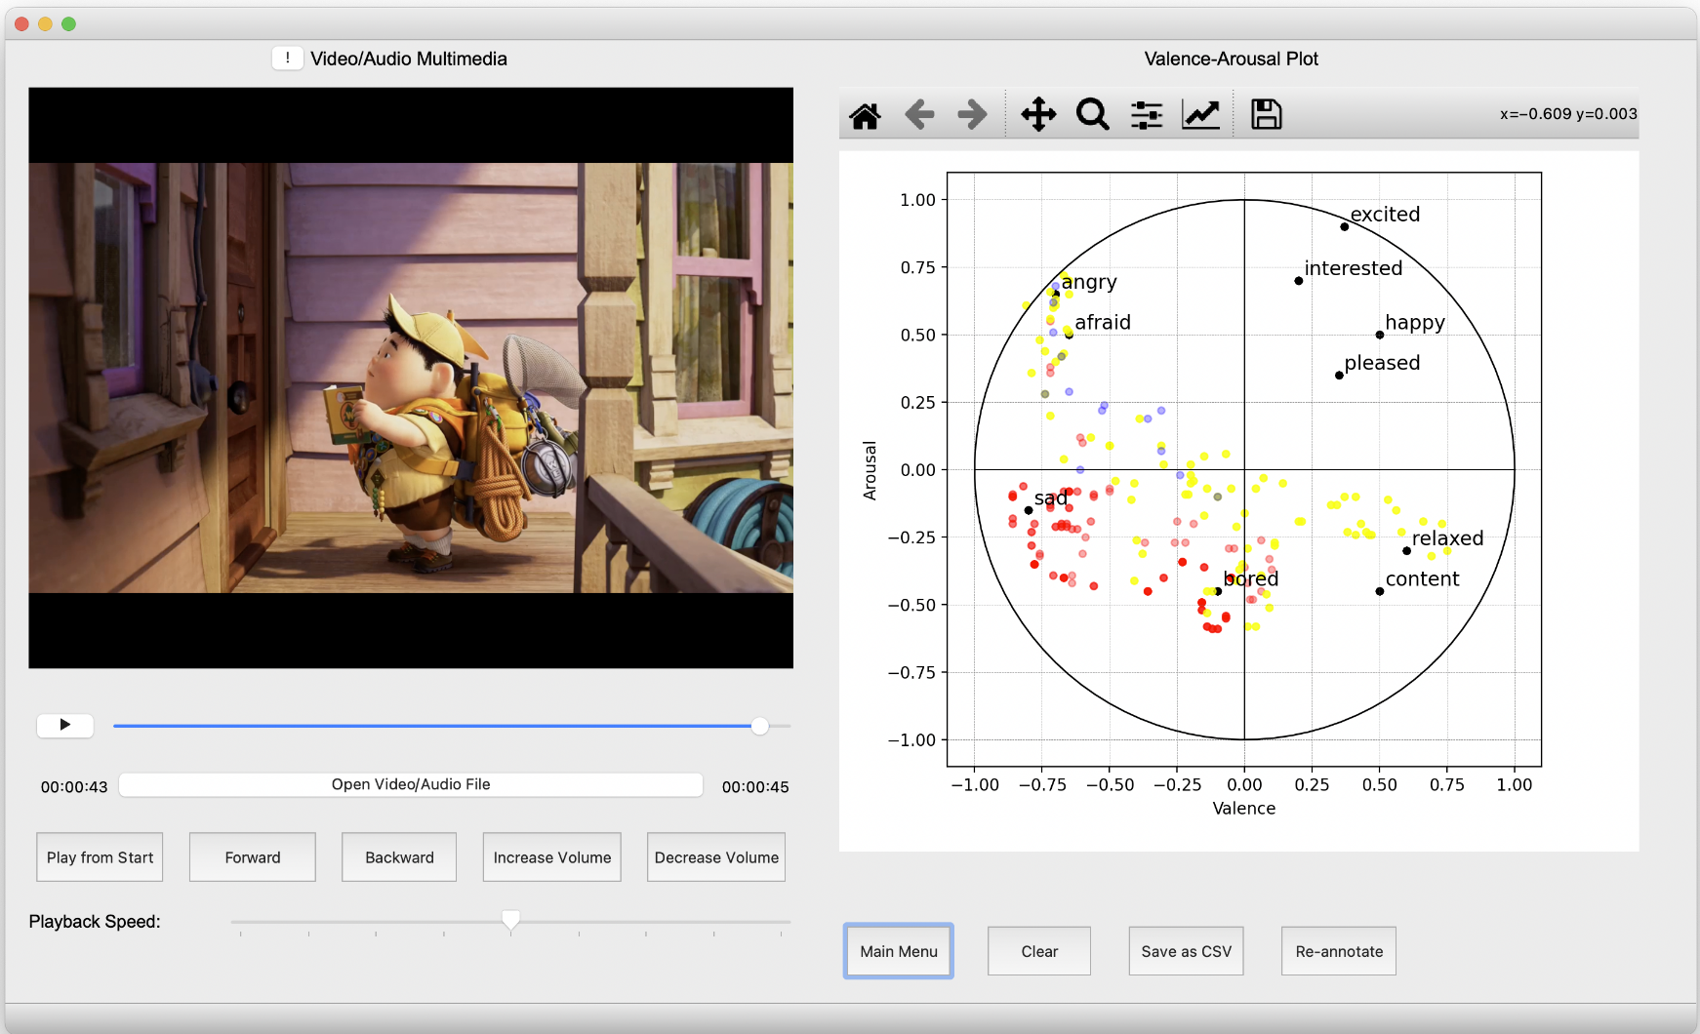
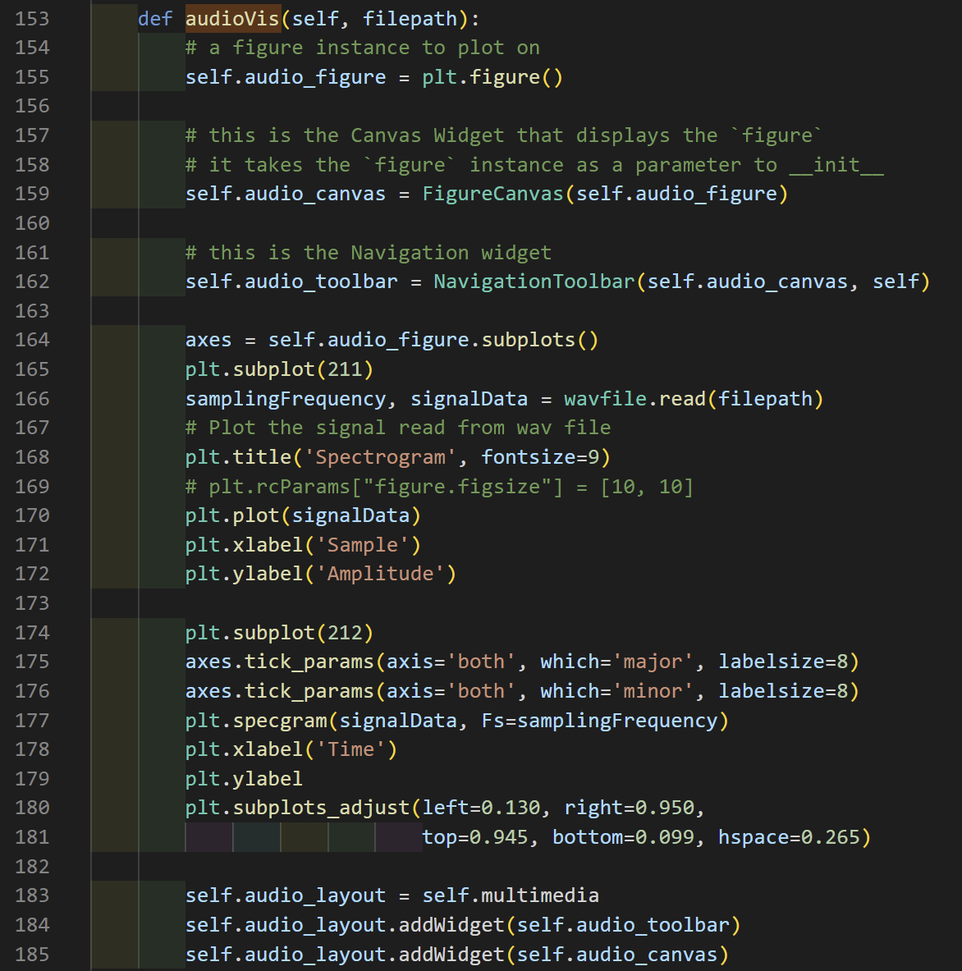
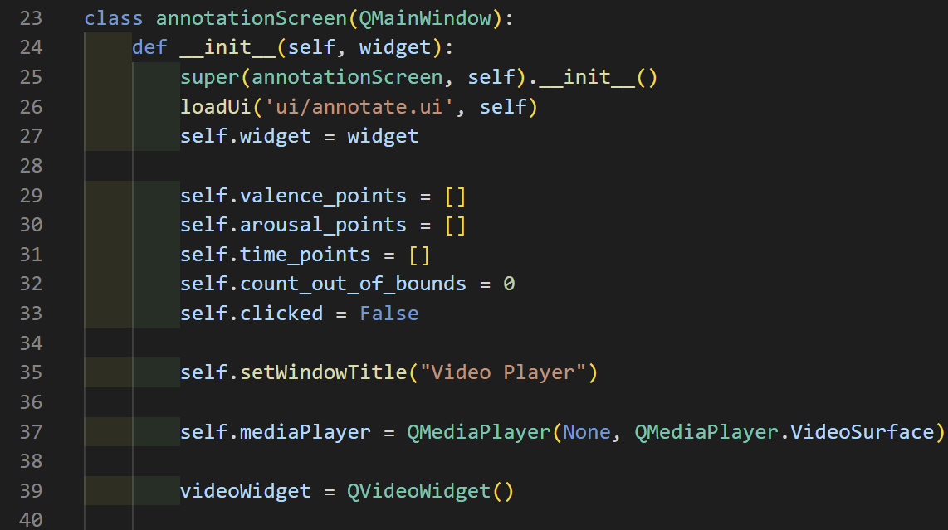
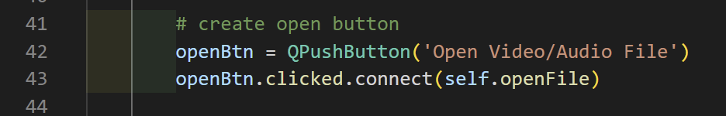
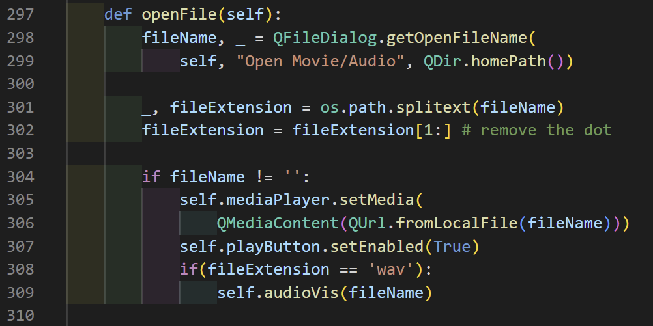
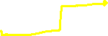
EmotionGui_ PyQt code understanding
Annotation Screen
Collections of arousal/valence points and time are recorded in arrays
When clicked ‘Open Video/Audio file, a file selector dialog pops up and a file is selected from the local machine. If filename is not empty, source the media content from the file path and enable the play button; if it’s a wav audio file, source the audio from the file path.

Slide 4
‘wav’ audio file calles audioVis, what does it do?
Missing an audio display?
Can’t find a plot of the spectrogram and audio tool bar

Slide 5
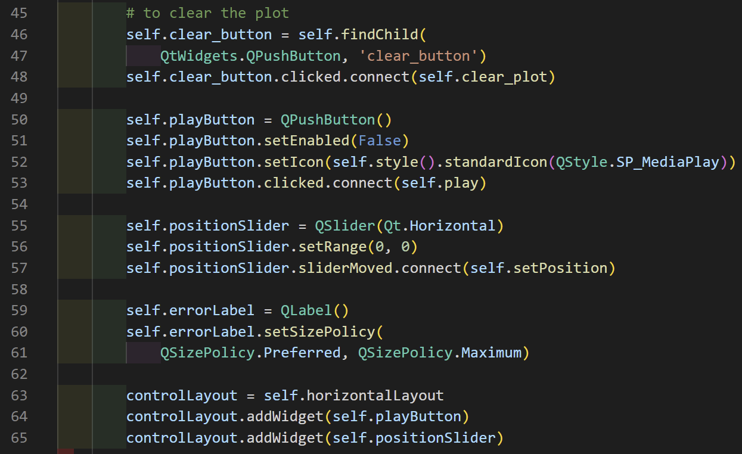
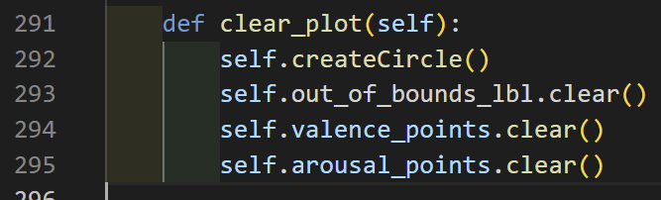
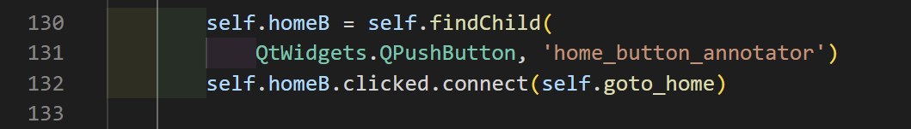
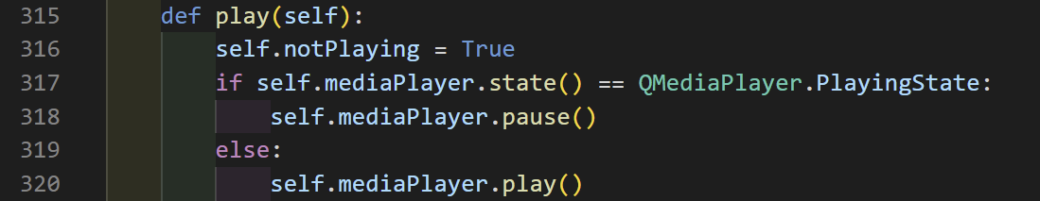
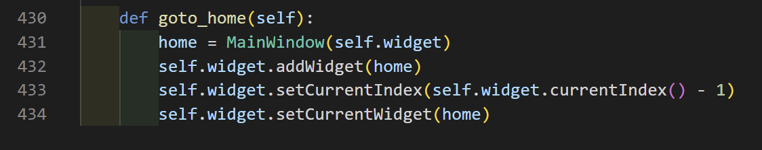
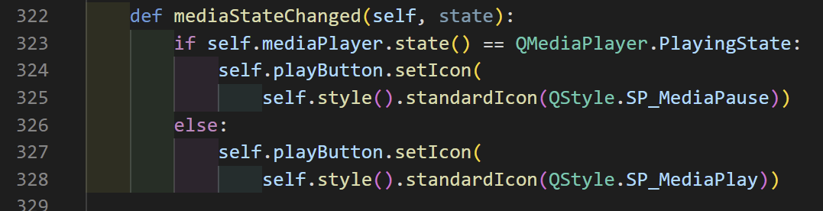
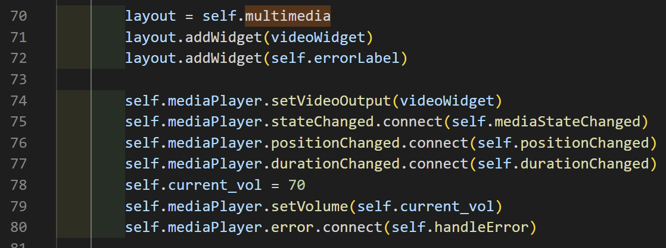
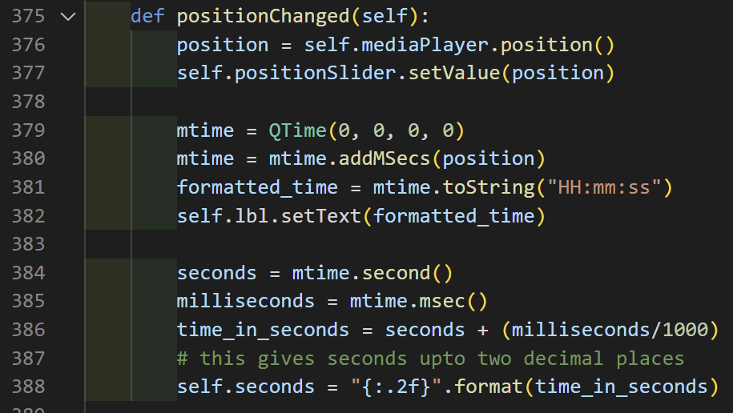
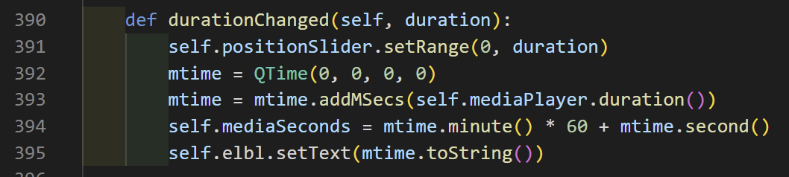
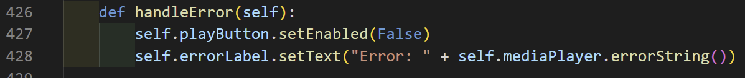

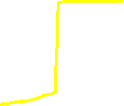


Mediaplayer control buttons and annotation plot control button
Multimedia layouts

Slide 6
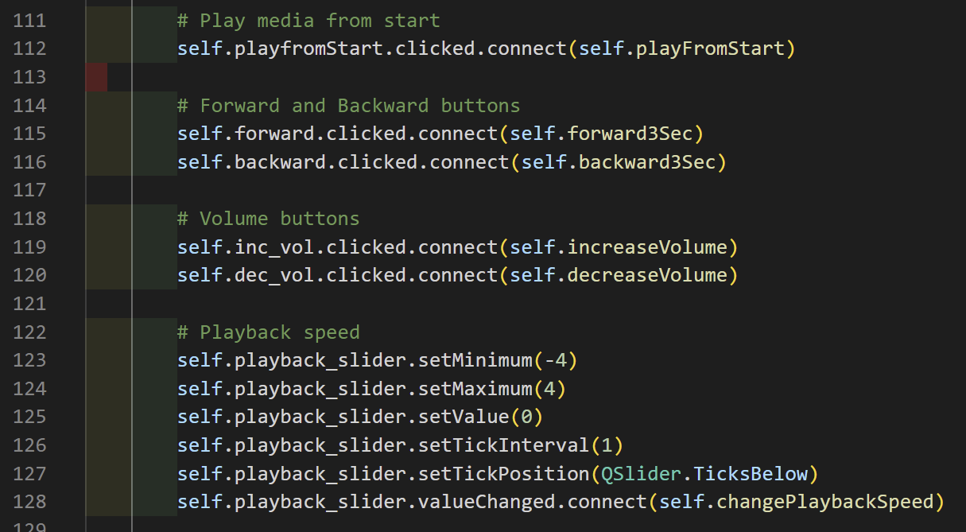
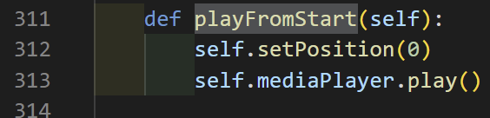
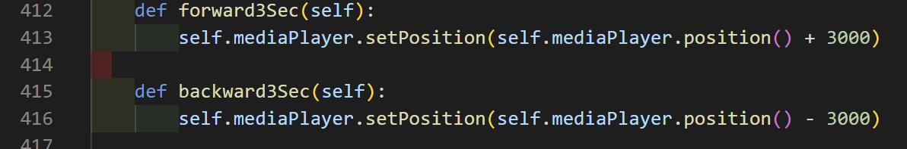
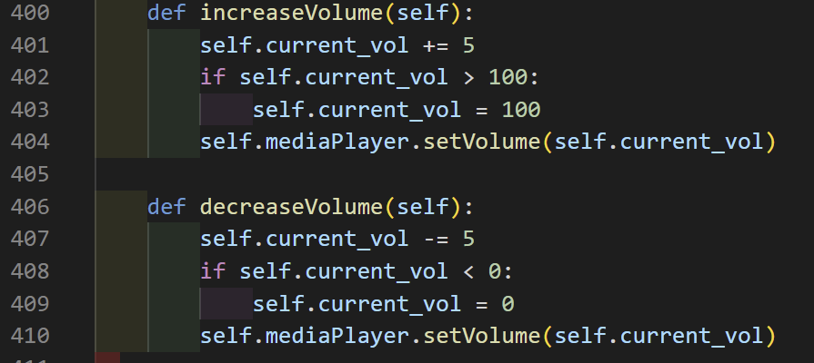
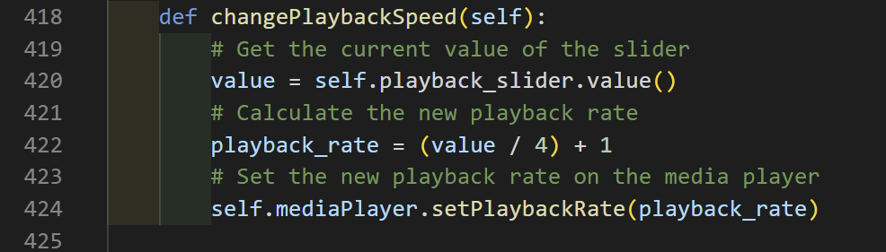

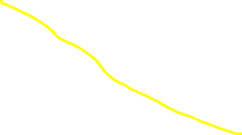
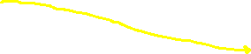
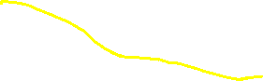

Mediaplayer control buttons

Slide 7
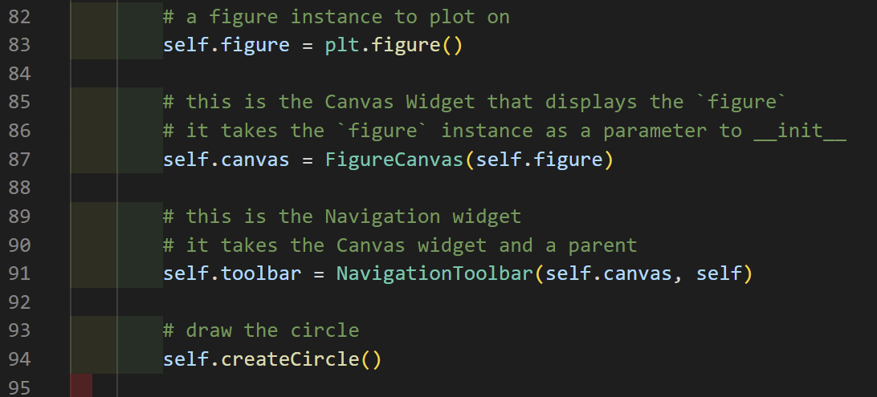
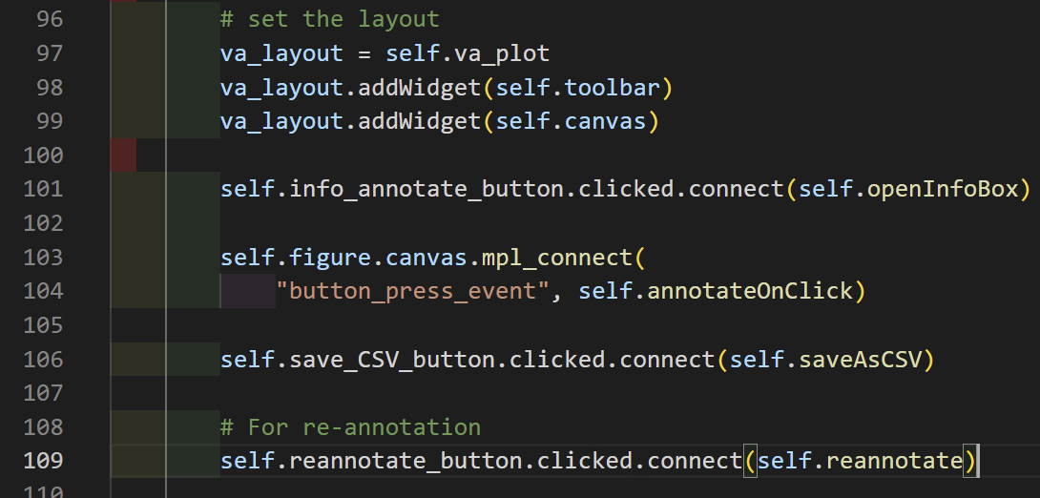
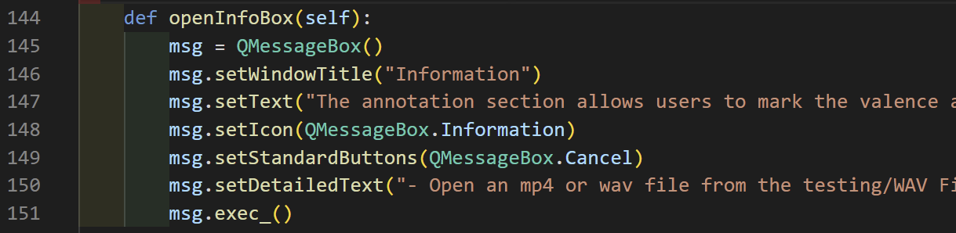
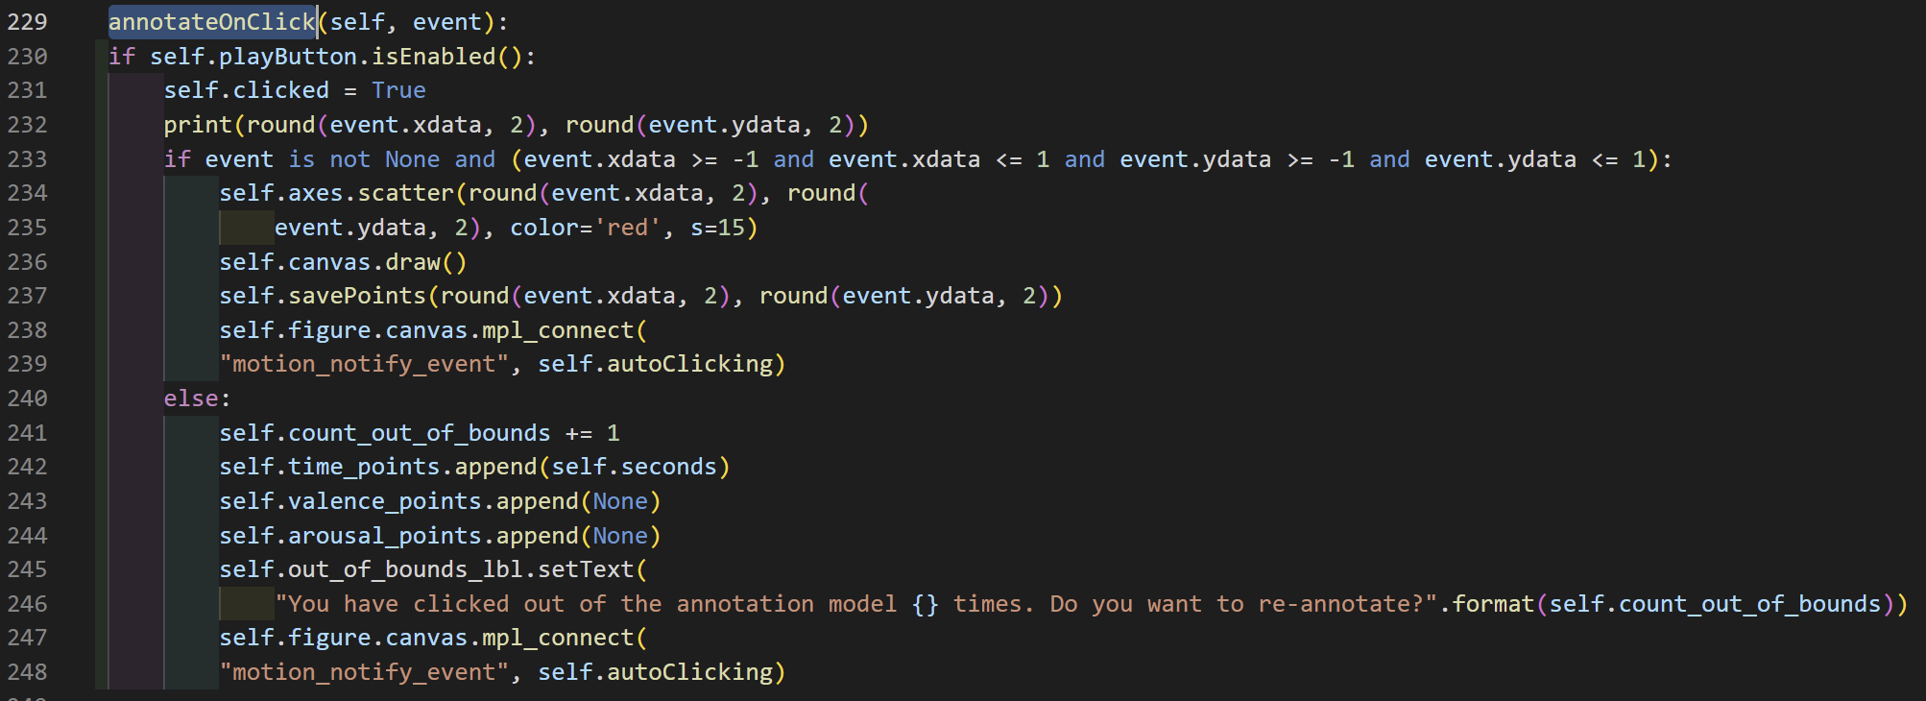
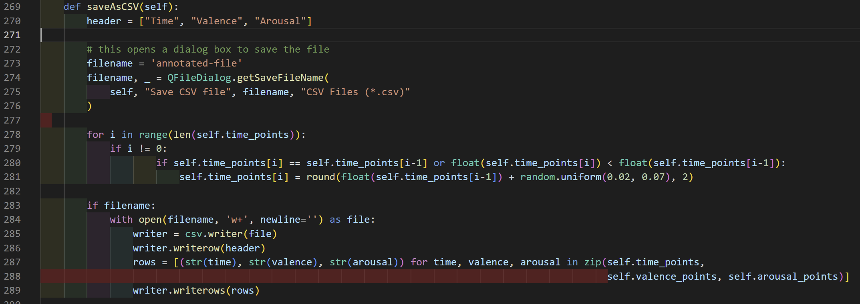
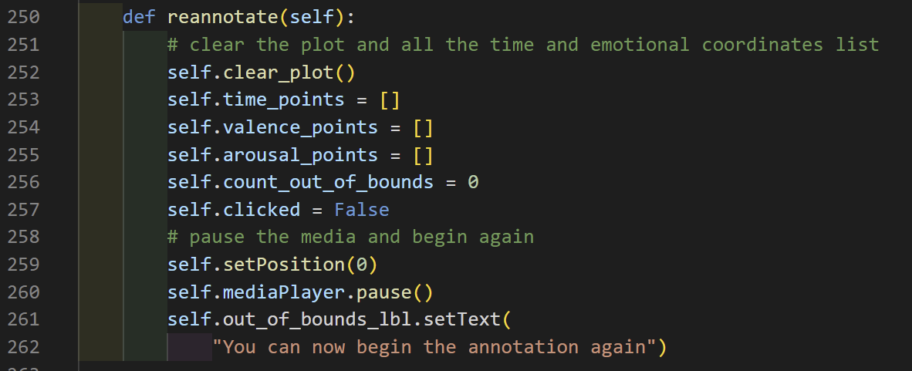
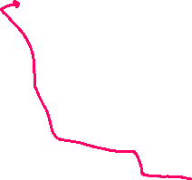


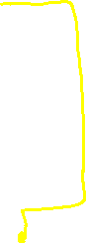


VA plot
Navigation Toolbar
Figure and circle displayed on canvas
annotationOnClick triggered by the playbutton pressed
- If mouse cursor placed within the va boundary, starts scatter plotting in red

Slide 8
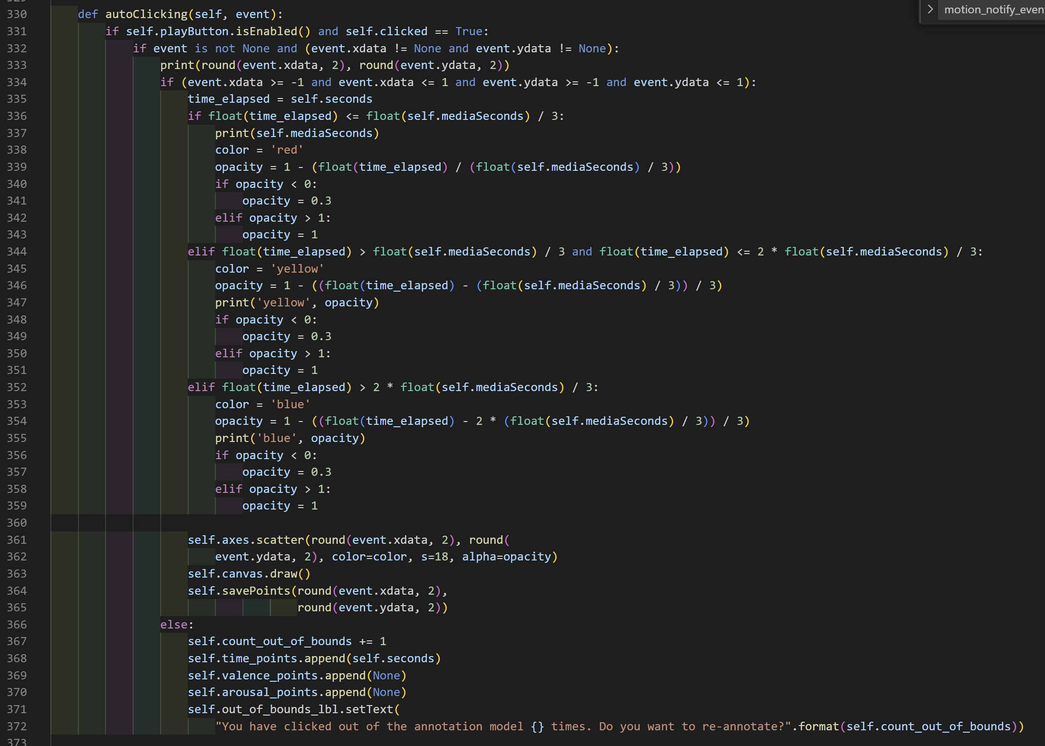
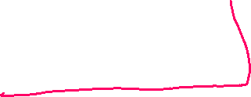
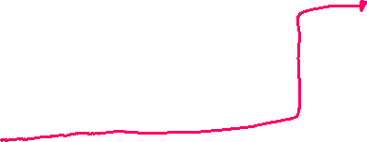
Annotation triggered by play-button
When play button is pressed;
- if mouse cursor is placed within VA boundary
-scatter plot in red , draw points on canvas
-save xdata and ydata points (V and A coordinates)
‘motion_notify_event’ trigger autoClicking method
Manipulate colour gradation, estimating time_elapsed
First 1/3 in red, second 1/3 in yellow and the rest in blue
scatter plot in colours accordingly, draw points on the canvas
Save V and A data
If clicked out of bound, no points added and inform user of clicked on out of annotation model and ask if wanting to reannotate

Slide 9
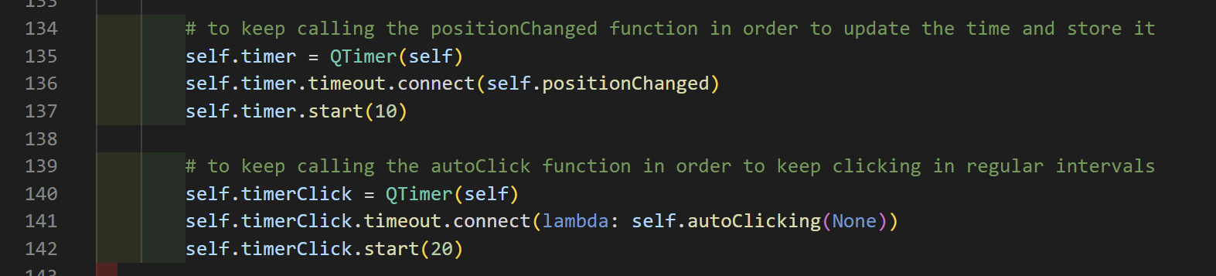
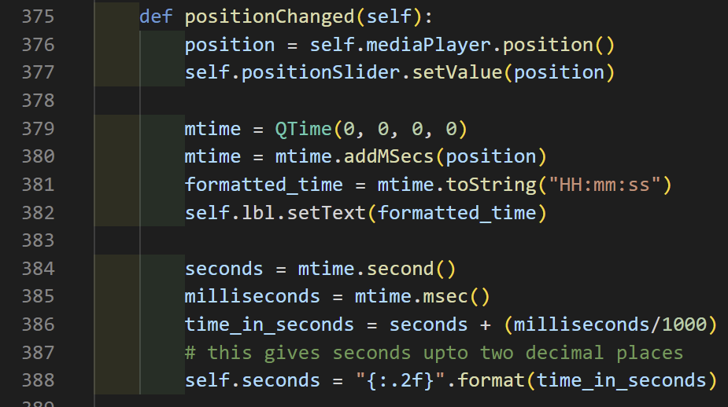
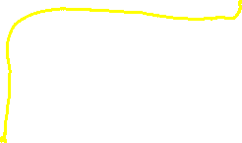
Like sampling rate ? Or timeout whenever autocliking triggerd?
Sync between media-player time and position on the slider bar
Update time w.r.t mediaplayer time and store time data

